Slide 1
Pizza sales data analysis using SQL
Presented by
S Nandana

Slide 2
Content
Introduction
Objective
Course content
Conclusion

Slide 3
Introduction
In today's competitive food industry, data-driven decision-making is essential for success. This project focuses on leveraging SQL queries to analyze sales data for a pizza company. By extracting insights such as revenue trends, popular menu items, and customer preferences, this analysis aims to provide actionable insights to enhance operational efficiency and drive profitability.

Slide 4
Objective
The objective of the above project is to utilize SQL queries to analyze sales data from a pizza company. By doing so, the project aims to achieve several goals:
1. Extract Insights: The primary objective is to extract valuable insights from the sales data, such as revenue trends, popular menu items, and customer preferences.
2. Inform Decision-Making: By uncovering these insights, the project seeks to inform strategic decision-making within the pizza company. This includes optimizing menu offerings, targeting marketing efforts, and improving operational efficiency.
3. Drive Profitability: Ultimately, the project aims to contribute to the company's bottom line by identifying opportunities to increase sales, reduce costs, and enhance overall profitability.
4. Enhance Operational Efficiency: By understanding sales patterns and customer behavior, the project also aims to help streamline operations and improve customer service.

Slide 5
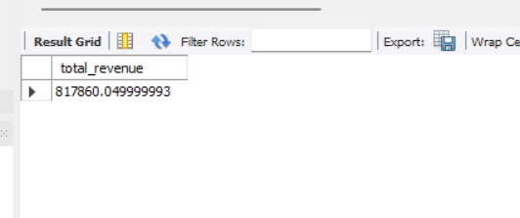
A.KPI’S-Key performance Indicators
The Key Performance Indicators obtained from the Dataset are
1. Total Revenue: This KPI represents the overall revenue generated from pizza sales within a specified period. It provides insight into the financial performance of the business and indicates the effectiveness of sales strategies.
select sum(total_price) as total_revenue from pizza_sales;

Slide 6
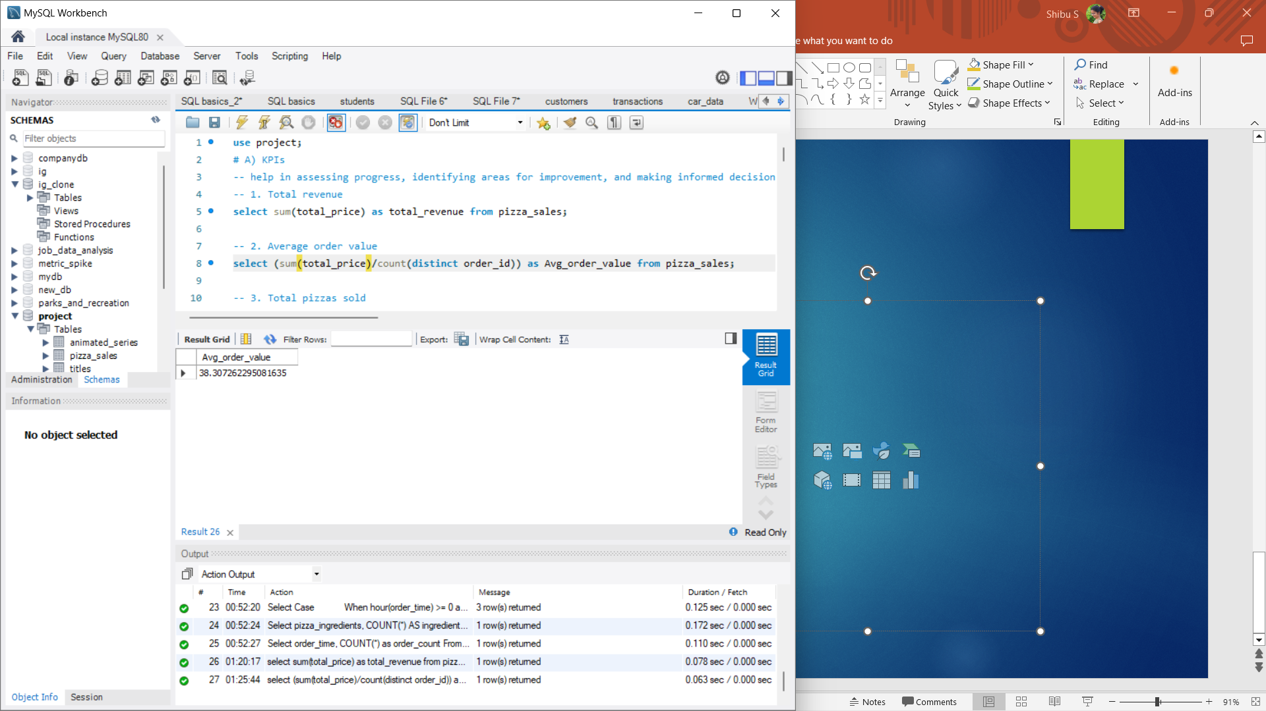
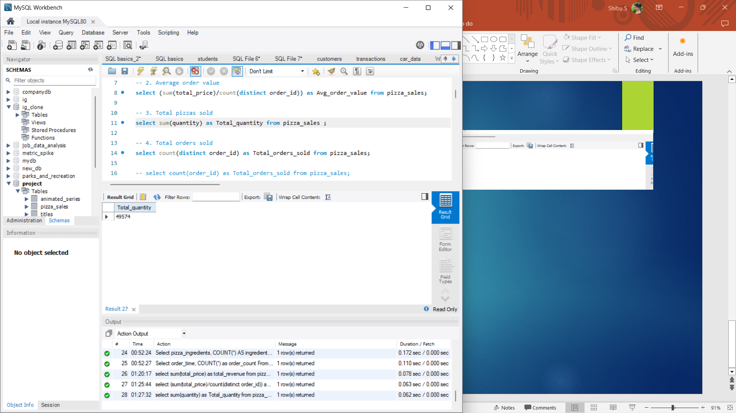
2. Average Order Value:
Average Order Value (AOV) is calculated by dividing the total revenue by the number of orders placed. AOV helps understand the average spending of customers per transaction, which is crucial for revenue optimization.
select (sum(total_price)/count(distinct order_id)) as Avg_order_value from pizza_sales;
3. Total Pizzas Sold:
This KPI quantifies the total number of pizzas sold over a given period. It reflects the demand for the product and helps track sales performance over time.
select sum(quantity) as Total_quantity from pizza_sales ;

Slide 7
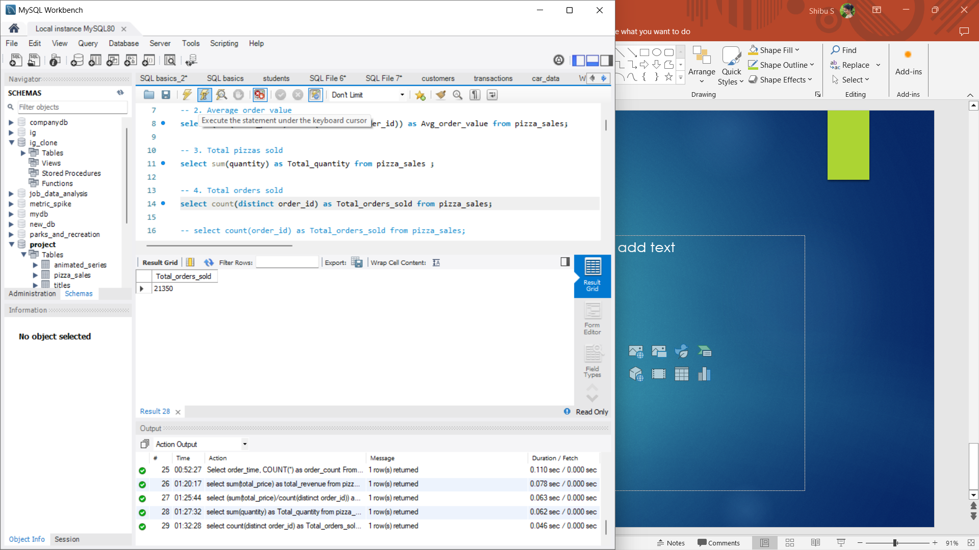
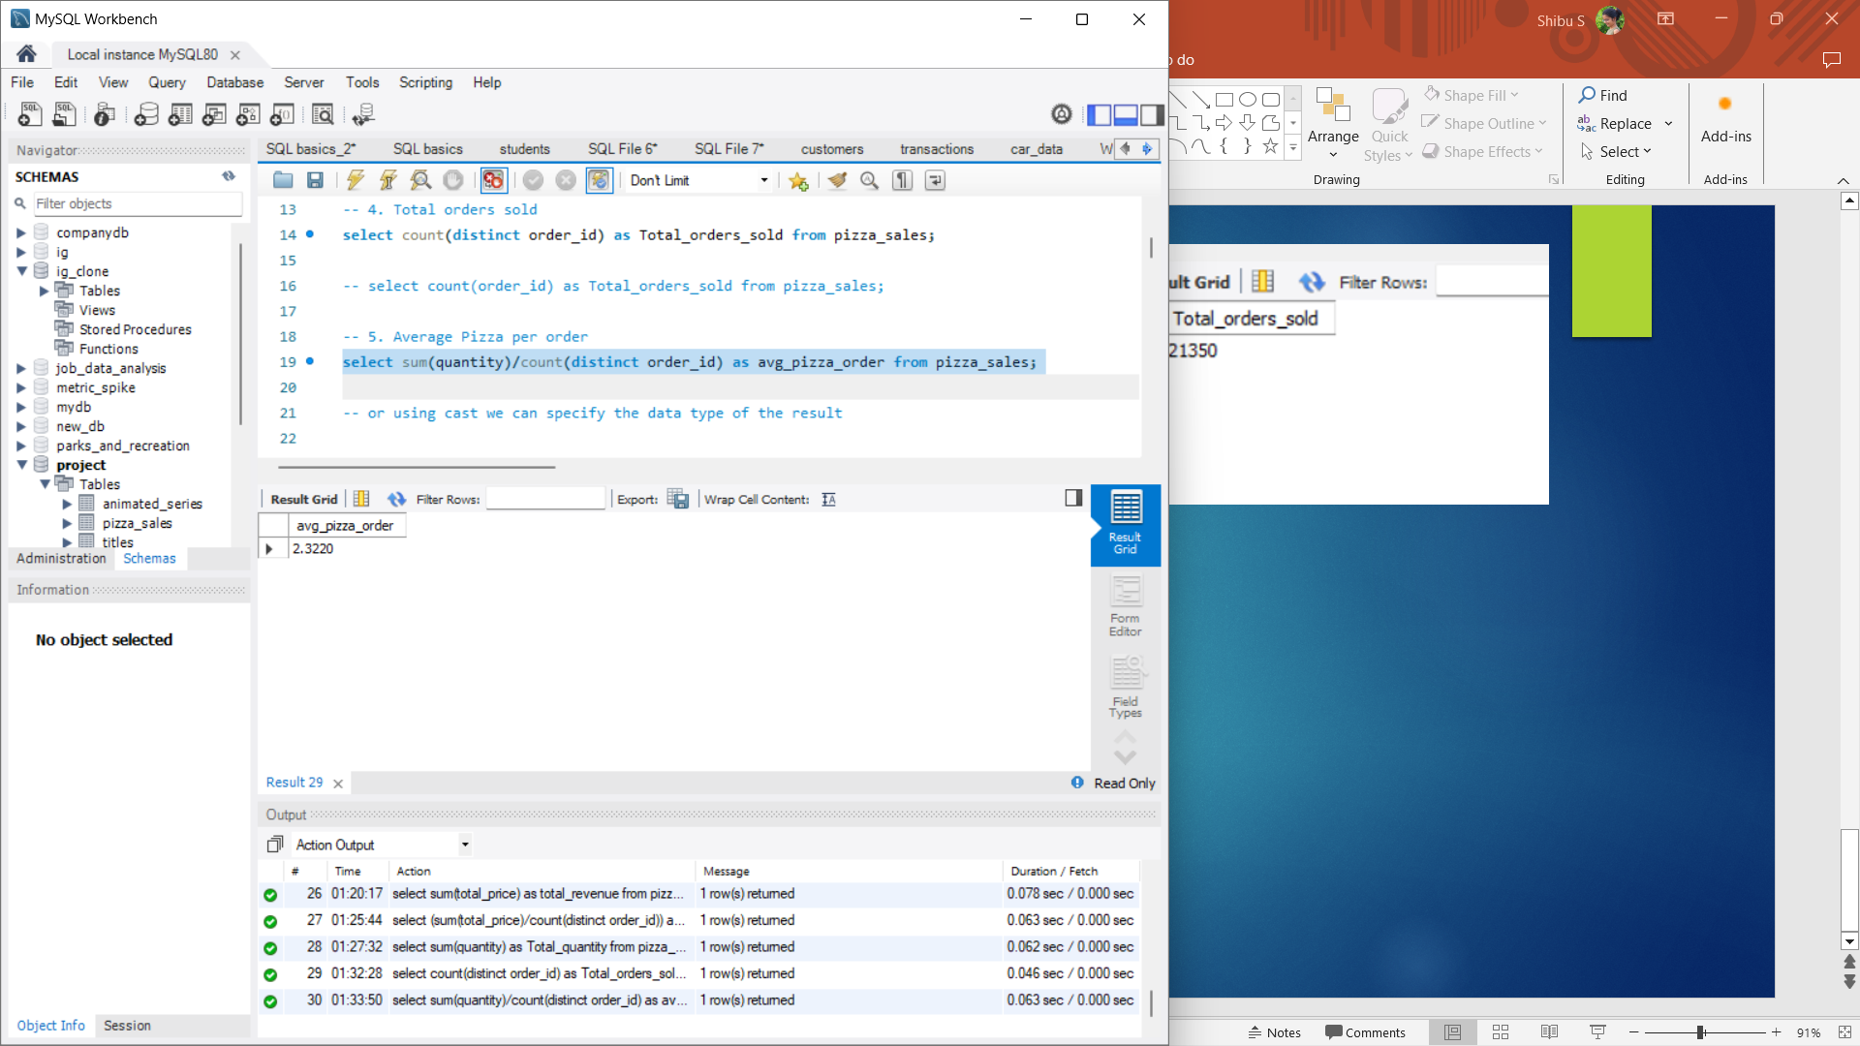
4. Total Orders Sold:
Total Orders Sold measures the total number of orders placed by customers. It indicates the volume of transactions processed by the business and helps assess customer engagement.
select count(distinct order_id) as Total_orders_sold from pizza_sales;
5. Average Pizza per Order:
Average Pizza per Order is calculated by dividing the total quantity of pizzas sold by the number of orders. This KPI provides insights into customer behavior, such as order size and preferences, which can influence marketing and product offerings.
select sum(quantity)/count(distinct order_id) as avg_pizza_order from pizza_sales;

Slide 8
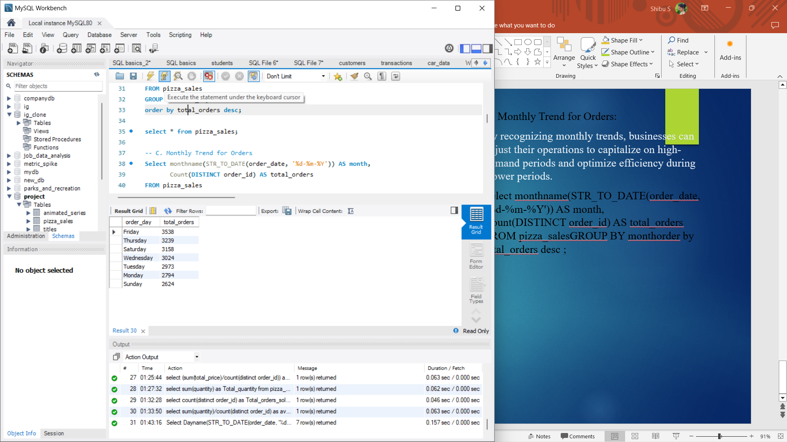
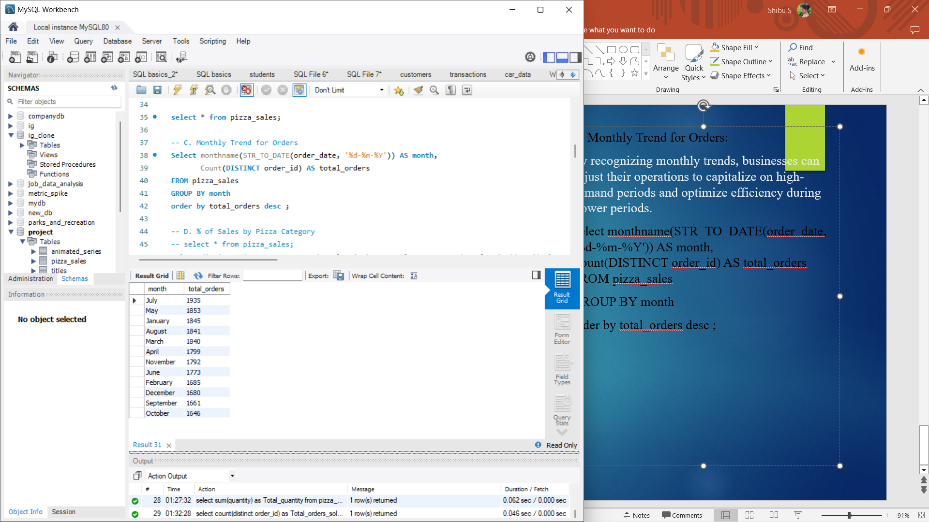
B. Daily Trend for Total Orders:
By analyzing the daily trend of total orders over a specific time period, we can identify patterns and fluctuations in order volumes on a daily basis.
Select Dayname(STR_TO_DATE(order_date, '%d-%m-%Y')) AS order_day,
Count(DISTINCT order_id) AS total_orders FROM pizza_sales
GROUP BY order_day
order by total_orders desc;
C. Monthly Trend for Orders:
By recognizing monthly trends, businesses can adjust their operations to capitalize on high-demand periods and optimize efficiency during slower periods.
Select monthname(STR_TO_DATE(order_date, '%d-%m-%Y')) AS month, Count(DISTINCT order_id) AS total_orders FROM pizza_sales
GROUP BY month
order by total_orders desc ;

Slide 9
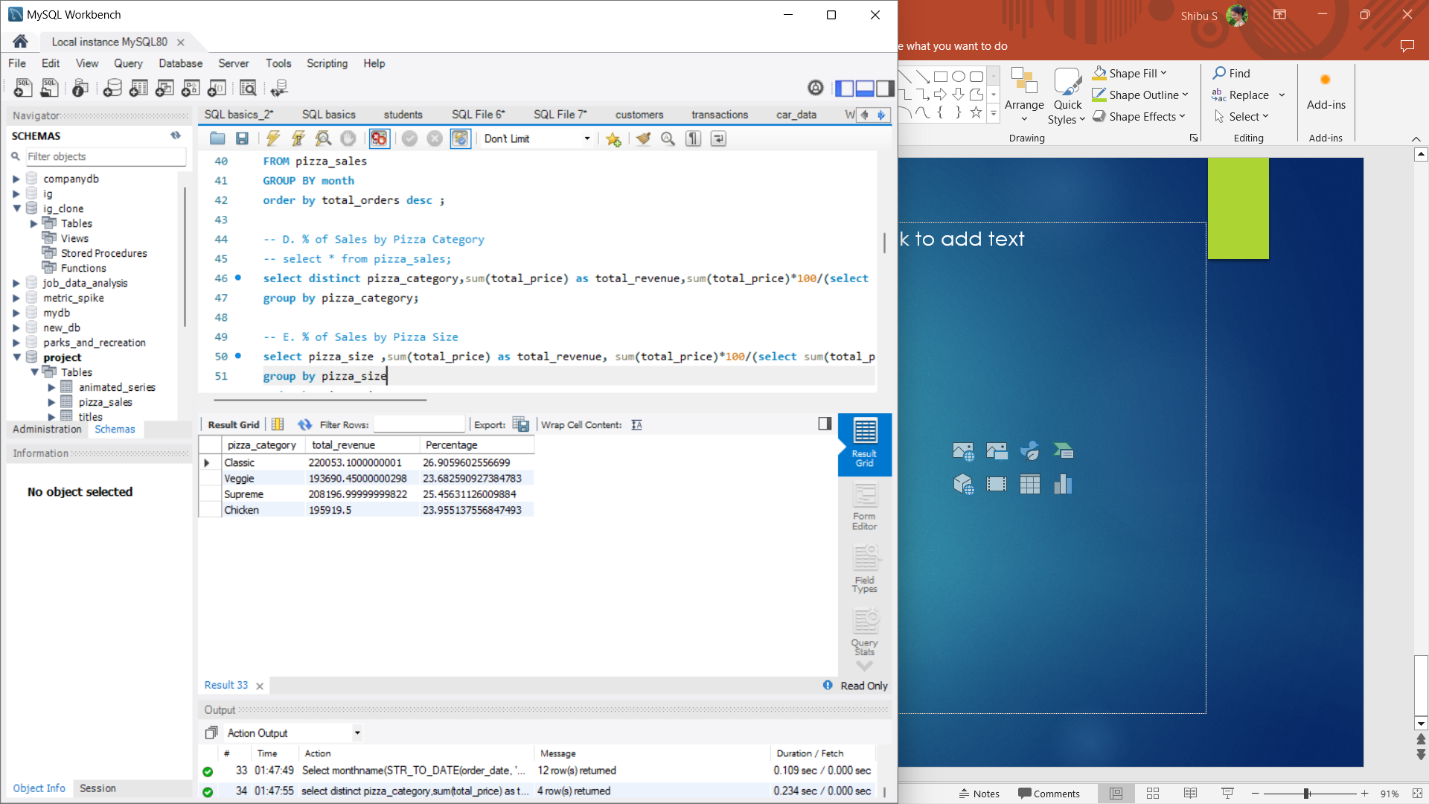
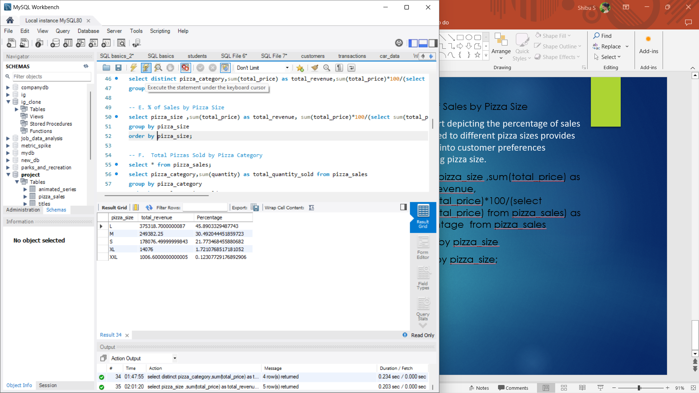
D. % of Sales by Pizza Category:
The distribution of sales across different pizza categories helps in understanding the popularity of each category and its contribution to overall sales.
select distinct pizza_category,sum(total_price) as total_revenue,sum(total_price)*100/(select sum(total_price) from pizza_sales) as Percentage from pizza_sales
group by pizza_category;
E. % of Sales by Pizza Size
The chart depicting the percentage of sales attributed to different pizza sizes provides insights into customer preferences regarding pizza size.
select pizza_size ,sum(total_price) as total_revenue, sum(total_price)*100/(select sum(total_price) from pizza_sales) as Percentage from pizza_sales
group by pizza_size
order by pizza_size;

Slide 10
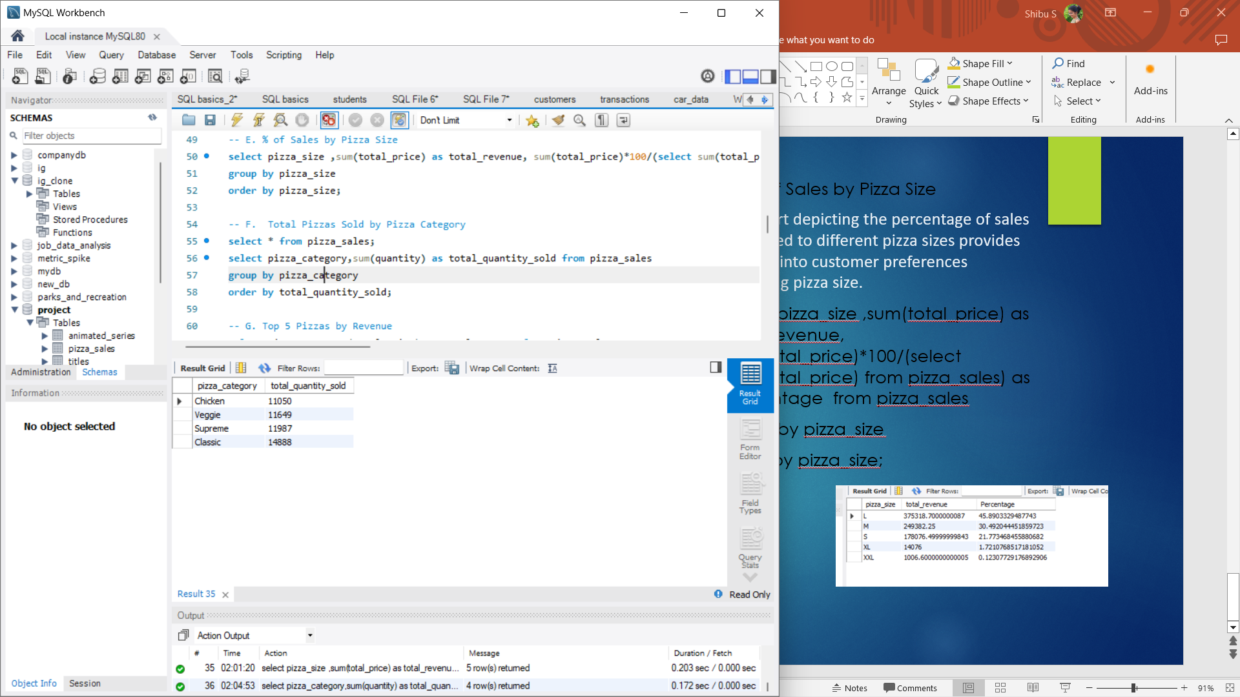
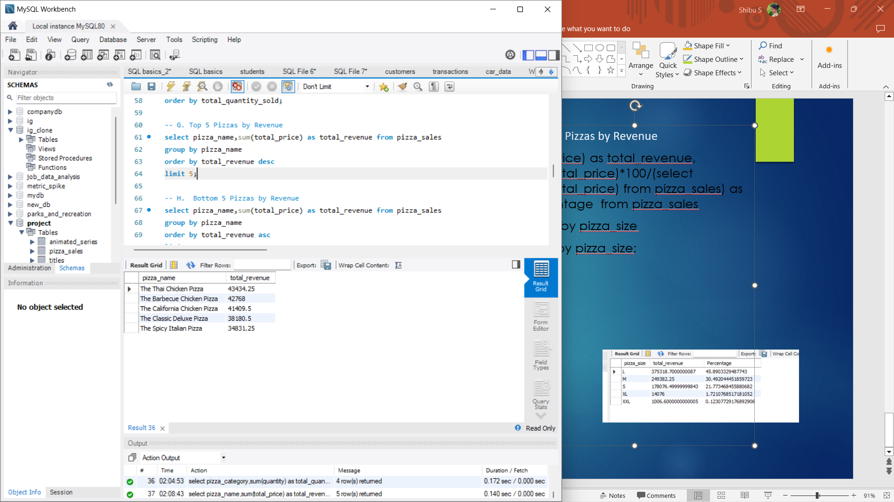
F. Total Pizzas Sold by Pizza Category
The metric showing a total number of pizzas sold for each pizza category enables comparison of sales performance across different categories. This helps in identifying popular and less popular pizza options, informing marketing strategies and menu adjustments accordingly.
select pizza_category,sum(quantity) as total_quantity_sold from pizza_sales
group by pizza_category
order by total_quantity_sold;
G. Top 5 Pizzas by Revenue:
Identifying the top 5 best-selling pizzas based on revenue, quantity sold, and total orders provides valuable insights into customer preferences. This information helps the pizza company target promotions effectively and tweak its menu to cater to popular choices, ultimately boosting sales and customer satisfaction.
select pizza_name,sum(total_price) as total_revenue from pizza_sales
group by pizza_name
order by total_revenue desc
limit 5;

Slide 11
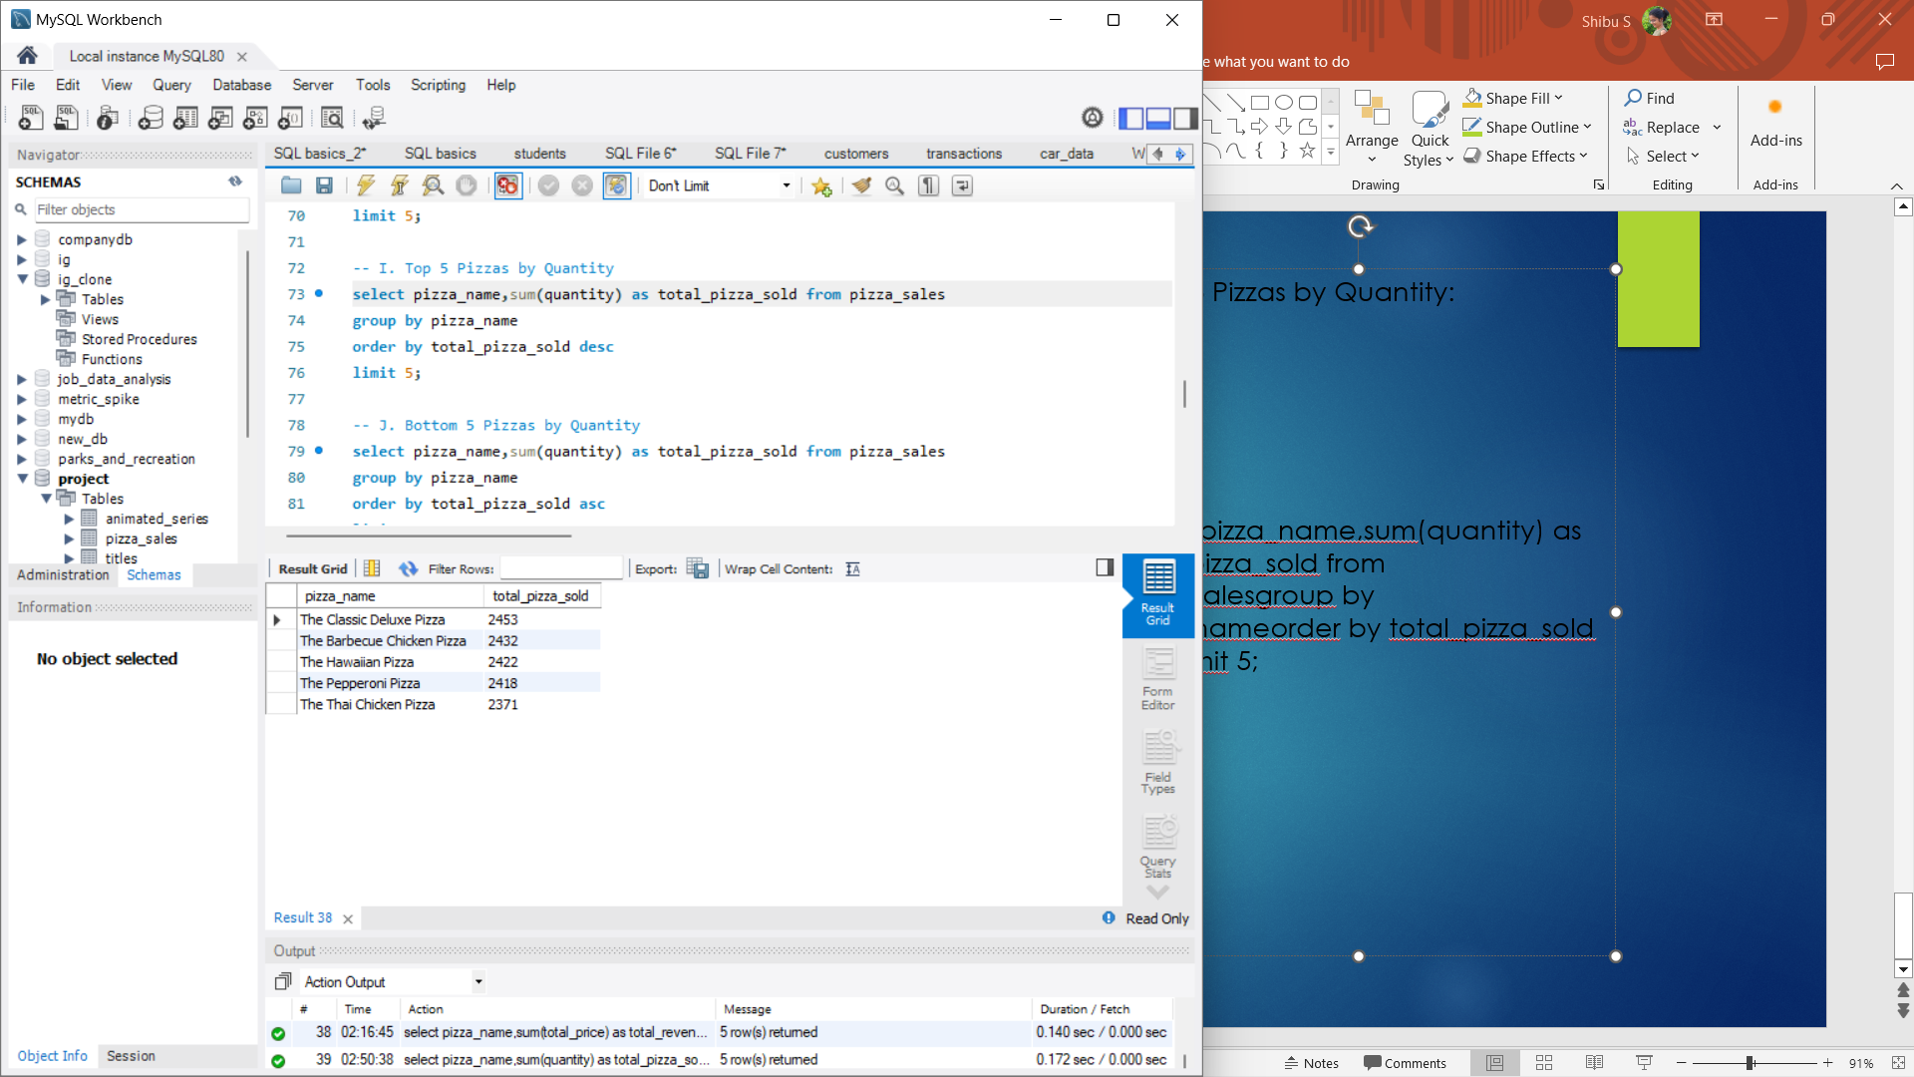
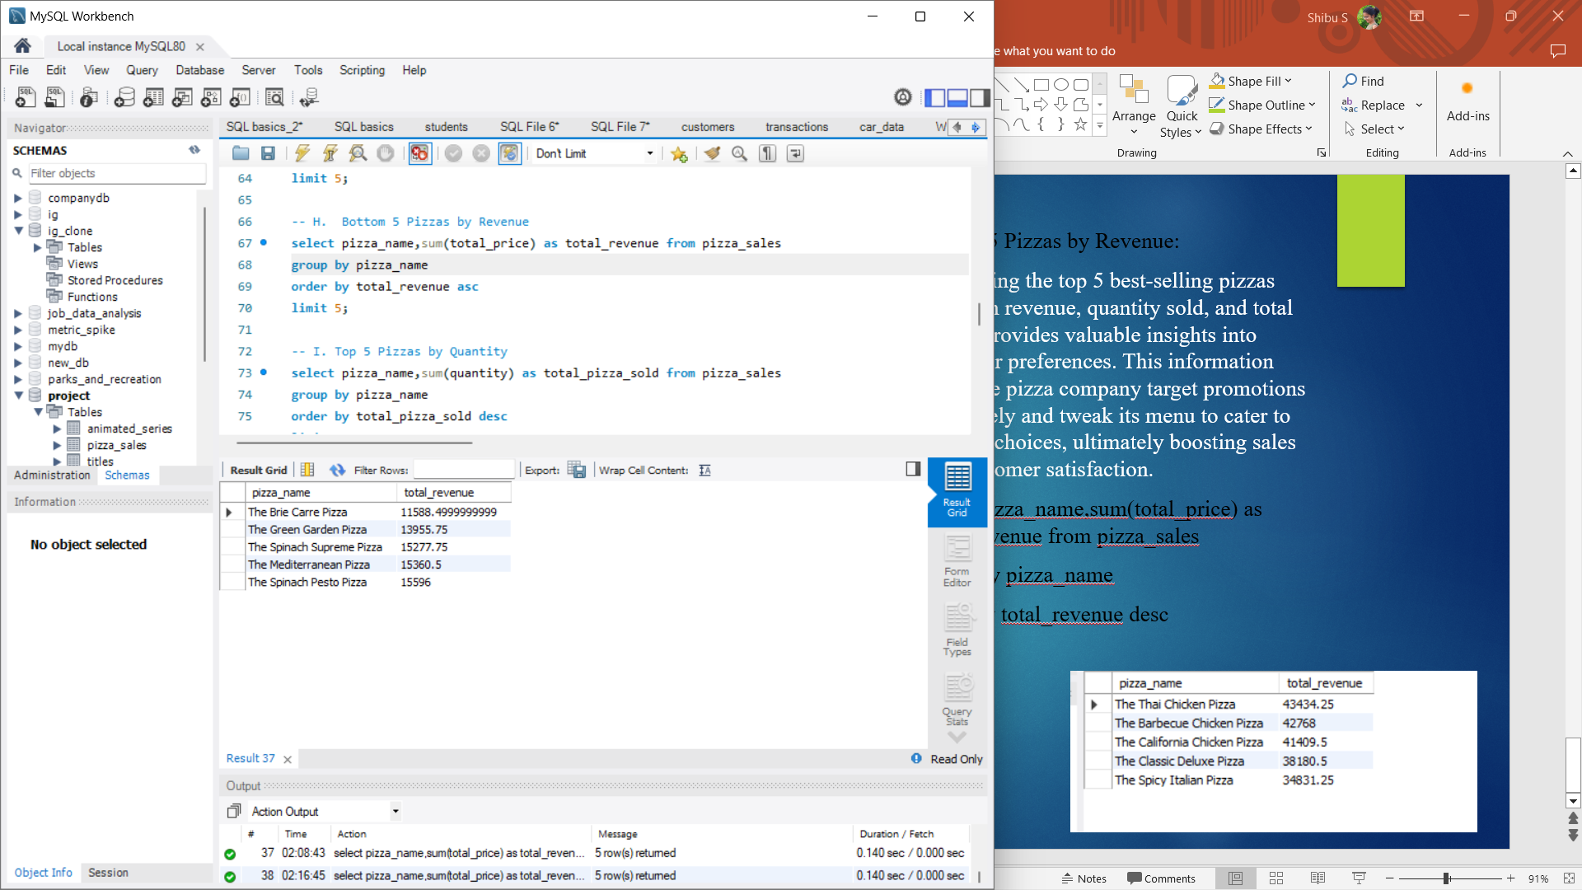
H. Bottom 5 Pizzas by Revenue
Highlighting the bottom 5 worst-selling pizzas based on revenue, total quantity, and total orders sheds light on less popular menu options. This data is crucial for strategic decision-making, like phasing out unpopular items or refining pricing and marketing tactics to stimulate sales.
select pizza_name,sum(total_price) as total_revenue from pizza_salesgroup by pizza_name
order by total_revenue asc
limit 5;
I. Top 5 Pizzas by Quantity:
The top 5 pizzas by quantity sold offers a glimpse into the favored pizza choices among customers. This knowledge aids in grasping customer preferences and facilitates focused marketing strategies or menu refinements to leverage popular items.
select pizza_name,sum(quantity) as total_pizza_sold from pizza_sales
group by pizza_name
order by total_pizza_sold desc
limit 5;

Slide 12
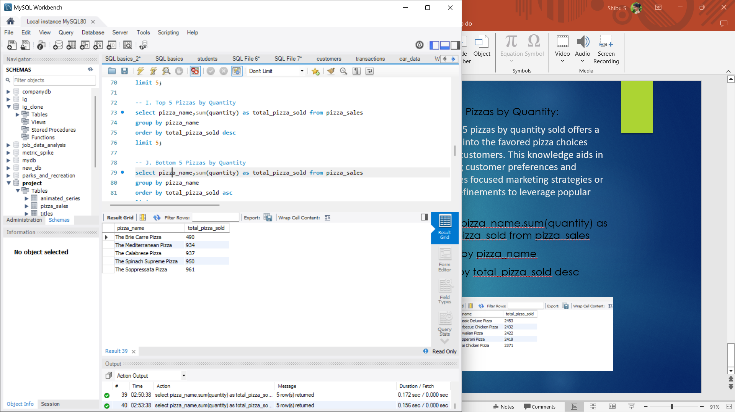
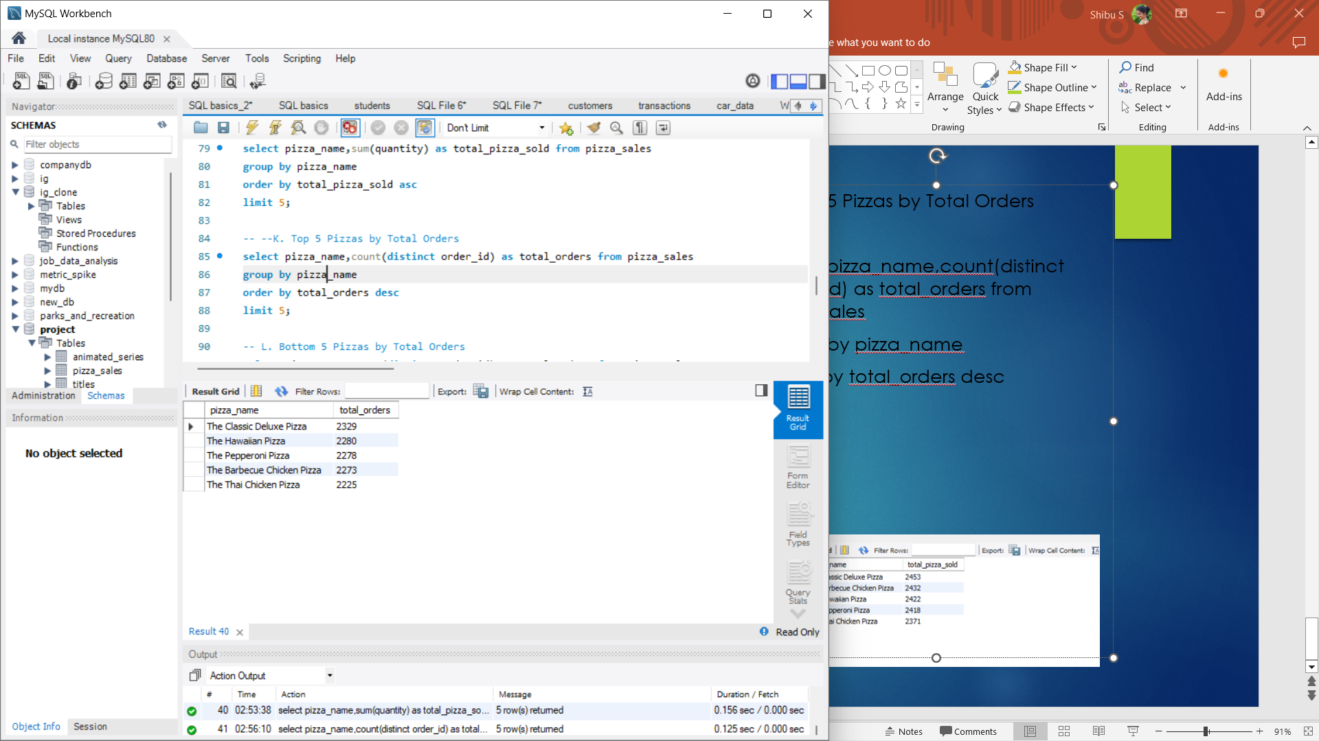
J. Bottom 5 Pizzas by Quantity
The bottom 5 pizzas by quantity sold draws attention to less favored or struggling pizza choices. This understanding can guide decisions on menu tweaks, promotional approaches, or inventory management strategies to reduce waste and boost profits.
select pizza_name,sum(quantity) as total_pizza_sold from pizza_sales
group by pizza_name
order by total_pizza_sold asc
limit 5;
K. Top 5 Pizzas by Total Orders
Spotlighting the top 5 pizzas by total orders reveals the pizza varieties that customers order most frequently. This insight into customer behavior and preferences empowers businesses to customize marketing strategies and menu options to better satisfy customer demand.
select pizza_name,count(distinct order_id) as total_orders from pizza_sales
group by pizza_name
order by total_orders desc
limit 5;

Slide 13

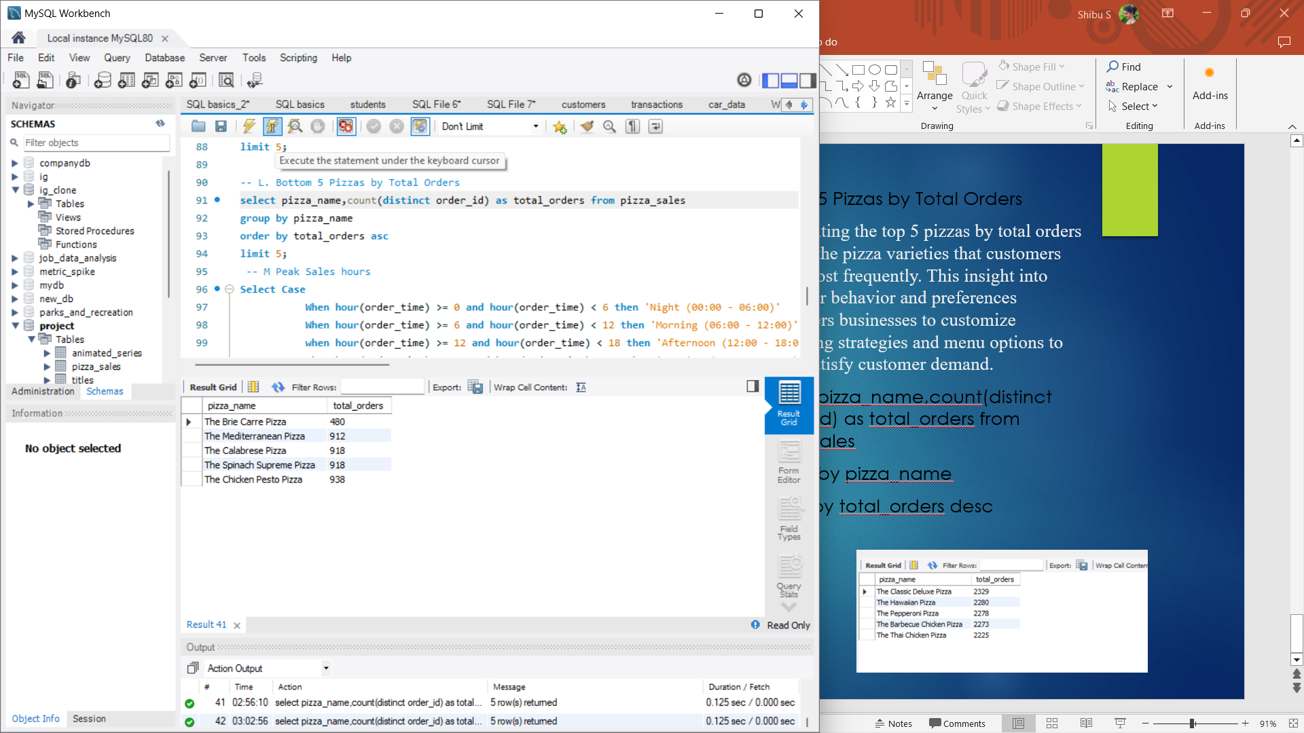
L. Bottom 5 Pizzas by Total Orders
Spotlighting the bottom 5 pizzas by total orders exposes niche or less favored menu selections that warrant consideration or modifications. Recognizing these patterns empowers businesses to make informed choices regarding menu tweaks, promotional tactics, or inventory handling to enhance sales and customer contentment.
select pizza_name,count(distinct order_id) as total_orders from pizza_salesgroup by pizza_name
order by total_orders asc
limit 5;
M. Peak Sales hours:
This helps to optimize staff and allocation
Select Case
When hour(order_time) >= 0 and hour(order_time) < 6 then 'Night (00:00 - 06:00)'
When hour(order_time) >= 6 and hour(order_time) < 12 then 'Morning (06:00 - 12:00)'
when hour(order_time) >= 12 and hour(order_time) < 18 then 'Afternoon (12:00 - 18:00)'
when hour(order_time) >= 18 and hour(order_time) < 24 then 'Evening (18:00 - 00:00)' end as time_segment,
COUNT(*) as total_orders
from pizza_salesgroup by time_segment
order by total_orders desc;

Slide 14
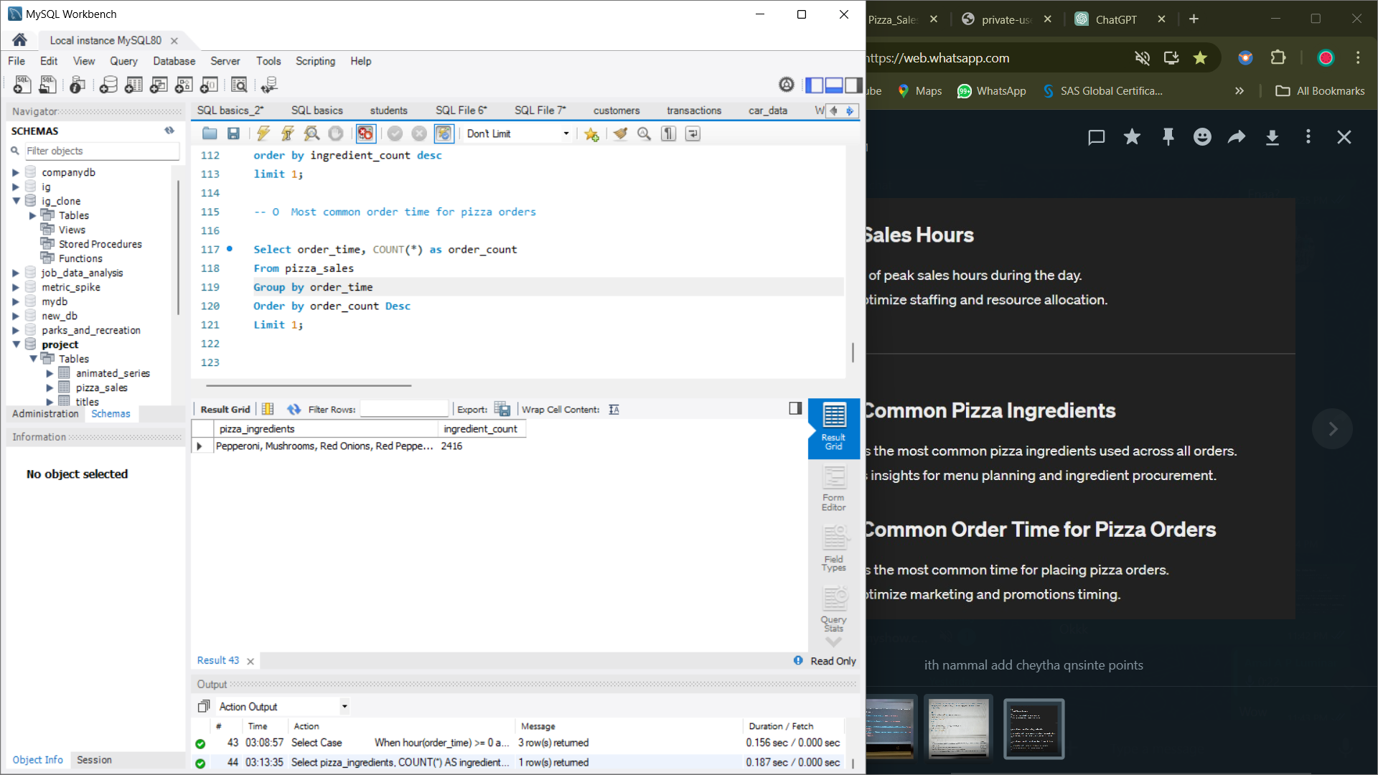
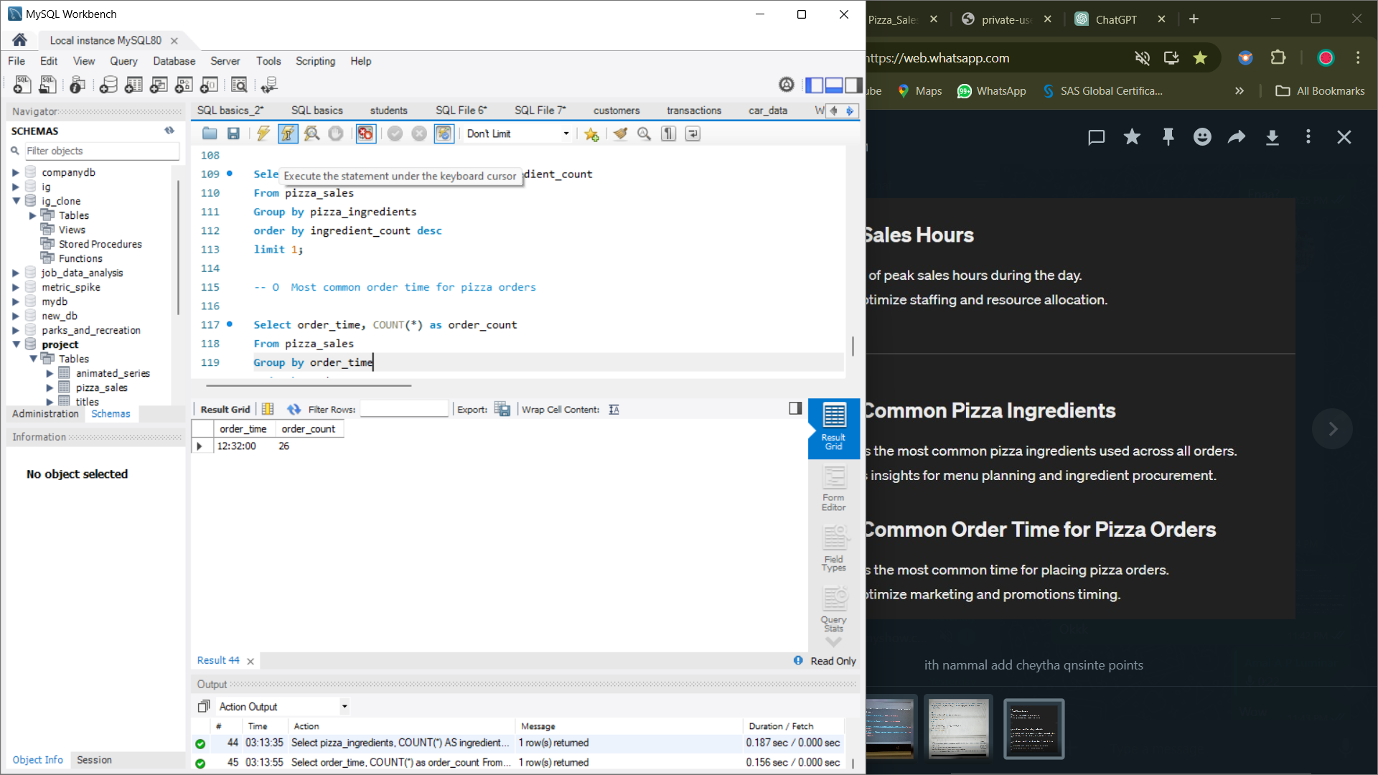
N, Most common pizza ingredients used across all orders
Identifies the most common pizza ingredients used across all orders and also provides insights for menu planning and ingredient procurement.
Select pizza_ingredients, COUNT(*) AS ingredient_countFrom pizza_sales
Group by pizza_ingredients
order by ingredient_count desc
limit 1;
O Most common order time for pizza orders
Identifies the most common time for placing pizza orders and helps optimize marketing and promotion timing.
Select order_time, COUNT(*) as order_count
From pizza_sales
Group by order_time
Order by order_count Desc
Limit 1;

Slide 15
Conclusion
In summary, through the analysis of pizza sales data using SQL queries, we've gained valuable insights into customer preferences, sales trends, and menu performance. These insights allow for informed decision-making, including optimizing menu offerings, refining marketing strategies, and enhancing operational efficiency. Overall, this project provides the pizza company with actionable insights to drive profitability, improve customer satisfaction, and remain competitive in the food industry.

Slide 16
Thank You

